Slide 1
SQL Statements

Slide 2
SQL Statements
SQL commands are grouped into 4 main categories
DDL (Data Definition Language)
CREATE
ALTER
DROP
TRUNCATE
RENAME
DML (Data Manipulation Language)
INSERT
DELETE
UPDATE
SELECT
Notes:
SQL Commands are used to manipulate and retrieve records from the database.
SQL commands are not case sensitive.
All SQL commands must be ended with a semicolon.

Slide 3
TCL (Transaction Control Language)
COMMIT
ROLLBACK
SAVEPOINT
DCL (Data Control Language)
GRANT
REVOKE

Slide 4
Naming Rules
Table and Column names should begin with a letter and may have numeric digits.
The length cannot exceed more than 30 characters.
It must contain only A-Z, a-z, 0-9 and special characters like _ , $ and #
Names must not be a Oracle keyword.
No two tables can have the same name owned by the same user.

Slide 5
Data Definition Language
DDL (Data Definition Language)
DDL commands are used in creating, making modifications, dropping the database objects.
CREATE command is used to create a new database object like table, View, Sequence etc.
To create a database object, say table, the user must have the CREATE TABLE privilege

Slide 6
Create Table
Syntax:
CREATE TABLE [schema name] tablename
(columnname datatype [DEFAULT expr] [, …] );
Specify the schema name in which the table has to be created. If omitted, the schema name will be same as that of the user’s account.
Specify the name of the table to be created.
Specify one or more names of the column along with the data types.
DEFAULT clause is used to specify a value to be assigned to that column in case a value is not entered.
The data type of the default expression must match the data type of the column.

Slide 7
Example
Create a table Student with the columns stuid with 4 digit , student name , class, registration date by setting it to default current system date.
CREATE TABLE student (stuid NUMBER(4),stname VARCHAR2(10),class NUMBER(4) DEFAULT 1 ,reg_date DATE DEFAULT SYSDATE);
SYSDATE an Oracle predefined function that returns current system date and time.
We will see more functions in later sessions

Slide 8
Alter Command
Add a column called course of character 10 bytes to the existing table student.
SQL> ALTER TABLE student ADD course VARCHAR2(10);
Modify the column course of character 10 bytes to 20 bytes in the existing table student.
SQL> ALTER TABLE student MODIFY course VARCHAR2(20);
Drop the column reg_date from the existing student table.
SQL> ALTER TABLE student DROP COLUMN reg_date;

Slide 9
Deleting a table
Syntax:
DROP TABLE tablename ;
Used to drop the entire table.
All the records and the structure of the table will be lost
Example:
SQL> DROP TABLE student;

Slide 10
Truncate Table
Syntax:
TRUNCATE TABLE tablename;
Removes all the records from the table.
Only the structure of the table remains
We cannot get back (rollback) the deleted records.
Releases the storage space used by the table.
Example:
SQL> TRUNCATE TABLE sales;

Slide 11
Renaming a table
Syntax:
RENAME TABLE tablename TO new_tablename ;
Used to provide a new name to the existing table.
This new table name will overwrite the previous table name.
Example:
SQL> RENAME TABLE student TO stud;

Slide 12
Data Manipulation Language
DML (Data Manipulation Language)
Add new rows to a table by using INSERT.
Modify existing rows in a table by using UPDATE.
Removing existing rows from the table using DELETE.
Selecting specific columns or all columns using SELECT.

Slide 13
Adding rows in a table
Syntax:
INSERT INTO table_name[(column [, column…. ] )]
VALUES(values [, values …..] );
INSERT is used to add one or more new records into the table.
The VALUES clause is used to assign values to the corresponding columns in the column list.
The columns can be listed in any order as long as the values in the VALUES clause are also in the same order. If columns are not specified, then all the columns are assumed. In such case, the order in which the values are entered must ne maintained.
Character data type values and Date values must be enclosed in single quotation mark. Numeric values need not be enclosed in quotes.

Slide 14


Examples on Insert
Insert a record in student table.
SQL> INSERT INTO Student VALUES(1234,'Beena',2 ,'1-MAR-2010')
Insert only 2 fields
SQL> INSERT INTO Student(stuid, stname) VALUES(2345,'Vikram');
SQL> INSERT INTO Student(class,stname) VALUES(2,'Ravi')
Look at the query above. How is it that data for the columns “CLASS” and “REG_DATE” has values in the 2nd row even though we have not entered?

Slide 15
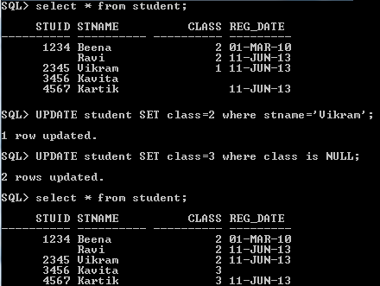
Examples on UPDATE
SQL> UPDATE student SET class=2 where stname='Vikram';
SQL> UPDATE student SET class=3 where class is NULL;

Slide 16

Delete table
Syntax:
DELETE FROM tablename [WHERE condition];
Used to remove the records from the table.
If WHERE clause is omitted, then all the records will be deleted from the table.
Presence of WHERE clause helps in deleting only the specific records based on the condition.
Example:
SQL> DELETE FROM student WHERE stuid is NULL;
Note that if you want to delete all records use TRUNCATE as is faster than DELETE.

Slide 17
COMMIT and ROLLBACK
Syntax:
COMMIT WORK; or
COMMIT;
Used to make all the changes permanent that were performed during the transactions.
Issuing a commit at the end of transactions saves the data permanently to the database.
Commit marks the end of the transaction.
Syntax:
ROLLBACK;
Used to reverse all or some of the database changes made during the transactions.

Slide 18
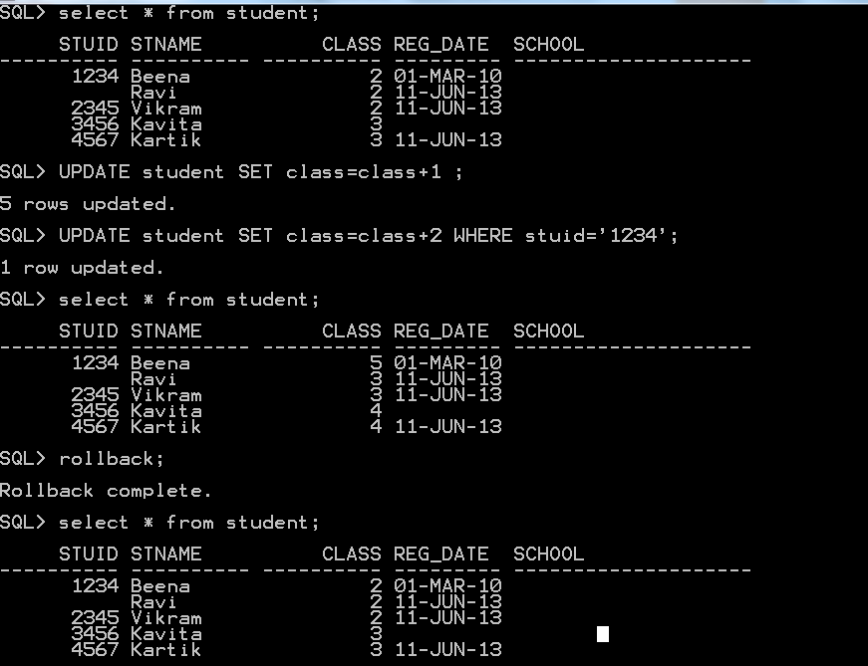
Example: COMMIT and ROLLBACK
Notes:
DDL statements are Auto-committed and permanently saved to the database.
DML statements can be rolled back.

Slide 19
SAVEPOINT
Note that when we issue COMMIT or ROLLBACK in the previous example, all the statements that were issues before the last COMMIT or ROLLBACK become part of the transaction.
Syntax:
SAVEPOINT savepoint_name;
COMMIT/ROLLBACK TO savepoint_name;
Used as a marker to identify the point up to which the transaction can be rolled back (from the last issued DML statement).
In other words, a transaction begins implicitly with the first statement issued since the last COMMIT or ROLLBACK or continues after a ROLLBACK TO SAVEPOINT.
Notes:
If two savepoints are created with the same name, then the previously declared savepoint will be erased.

Slide 20
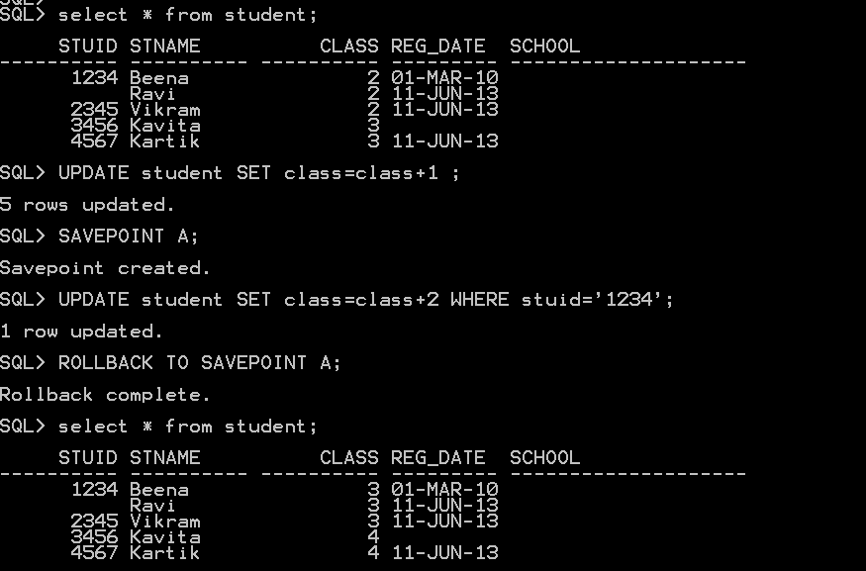

Slide 21
Data Control Language
DCL statements are about giving user access to the database objects.
It enforces security to the database.
GRANT & REVOKE are the only statements that constitute DCL.
These privileges are given by the Database Administrator (DBA)
There are 2 types of Privileges
System Privileges – This allows the user to Create, Alter and Drop the database objects. They are fundamentally DDL operations permissions
Object Privileges - This allows the user to Select, Insert, Update or Delete database objects i.e., DML operation permissions

Slide 22
Example
Grant SELECT privilege on Student table to mary.
GRANT SELECT ON student TO mary;
Connect to mary and try to access Student table.
SQL> CONNECT mary/mary
Connected.
SQL> select * from system.student;
List of students displayed
Grant execute privilege to mary such that she can give this privilege to any other user.
SQL> GRANT EXECUTE ANY PROCEDURE TO mary WITH ADMIN OPTION;

Slide 23
Revoke privilege
Syntax:
REVOKE privilege_name ON object_name
FROM user_name|PUBLIC|role_name;
Used to remove access on database objects from other users.
Example:
SQL> REVOKE SELECT ON student FROM mary;

